Slide 1
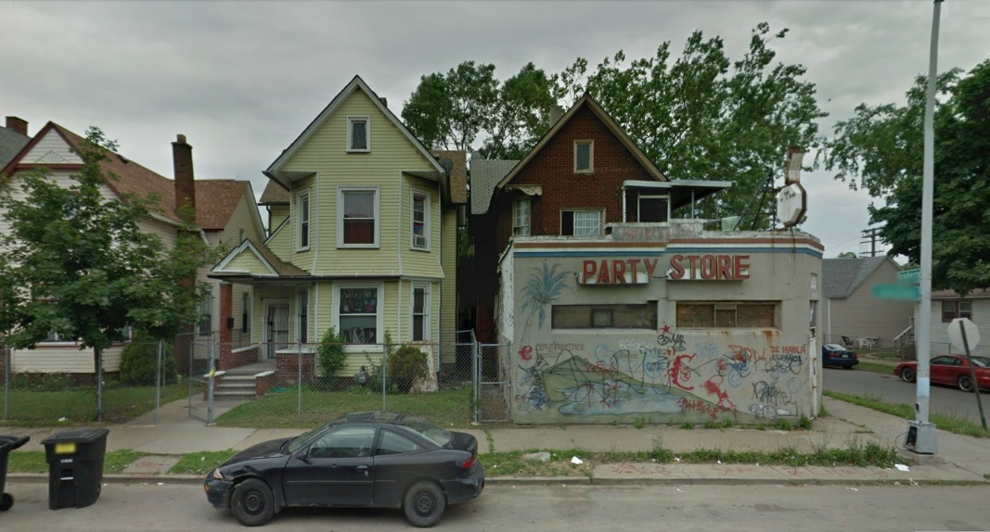
My first home
It may not be much to many but this was the place I called home when I was a young boy. We lived in Dearborn the slums of Detroit, Michigan. The 3rd floor was rented out to an older man named Mr. McPhee. The other two floors held me, my four brothers and our parents.
My dad owned the store on the corner for a few years so it was convenient to live so close, plus I got lots of free goodies.
Notes:
Rotating tubes with text
(Intermediate)
To reproduce the first shape effect on this slide, do the following:
On the Home tab, in the Slides group, click Layout, and then click Blank.
On the Insert tab, in the Illustrations group, click Shapes, and then under Rectangles click Rectangle (first option from the left). On the slide, drag to draw a rectangle.
Select the rectangle. Under Drawing Tools, on the Format tab, in the Size group, do the following:
In the Shape Height box, enter 0.75”.
In the Shape Width box, enter 7.42”.
Drag the rectangle above the middle of the slide, and then align the right edge with the right edge of the slide.
Under Drawing Tools, on the Format tab, in the Shape Styles group, click Shape Effects, point to Reflection, and then under Reflection Variations click Tight Reflection, touching.
On the Home tab, in the bottom right corner of the Drawing group, click the Format Shape dialog box launcher. In the Format Shape dialog box, click Fill in the left pane, select Gradient fill in the Fill pane, and then do the following:
In the Type list, select Linear.
In the Direction list, select Linear Up (second row, second option from the left).
Under Gradient stops, click Add gradient stop or Remove gradient stop until four stops appear in the slider.
Also under Gradient stops, customize the gradient stops as follows:
Select the first stop in the slider, and then do the following:
In the Position box, enter 0%.
Click the button next to Color, and then under Theme Colors click Blue, Accent 1, Lighter 40% (fourth row, fifth option from the left).
Select the next stop in the slider, and then do the following:
In the Position box, enter 26%.
Click the button next to Color, and then under Theme Colors click White, Background 1, Darker 5% (second row, first option from the left).
Select the next stop in the slider, and then do the following:
In the Position box, enter 80%.
Click the button next to Color, and then under Theme Colors click Black, Text 1, Lighter 50% (second row, second option from the left).
Select the last stop in the slider, and then do the following:
In the Position box, enter 100%.
Click the button next to Color, and then under Theme Colors click White, Background 1, Darker 35% (fifth row, first option from the left).
Also in the Format Shape dialog box, click Line Color in the left pane. In the Line Color pane, select No line.
Also in the Format Shape dialog box, click Shadow in the left pane. In the Shadow pane, click the button next to Presets, under Outer click Offset Center, and then do the following:
In the Transparency box, enter 60%.
In the Size box, enter 102%.
In the Blur box, enter 5 pt.
In the Angle box, enter 0°
In the Distance box, enter 0 pt.
On the slide, select the rectangle. On the Home tab, in the Clipboard group, click the arrow to the right of Copy, and then click Duplicate.
Select the second, duplicate rectangle. Under Drawing Tools, on the Format tab, in the Shape Styles group, click Shape Effects, point to Reflection, and then click No Reflection.
On the Home tab, in the bottom right corner of the Drawing group, click the Format Shape dialog box launcher. In the Format Shape dialog box, click Fill in the left pane. In the Fill pane, click the button next to Direction, and then click Linear Down (first row, second option from the left).
Also in the Format Shape dialog box, click Shadow in the left pane. In the Shadow pane, click the button next to Presets, and then under No Shadow click No Shadow.
On the slide, drag the second rectangle until it is directly on top of the first rectangle.
On the Home tab, in the Editing group, click Select, and then click Selection Pane.
In the Selection and Visibility pane, press and hold CTRL, and then select both rectangles. On the Home tab, in the Drawing group, click Arrange, point to Align, and then do the following:
Click Align Selected Objects.
Click Align Center.
Click Align Middle.
To reproduce the first text effect on this slide, do the following:
On the Insert tab, in the Text group, click Text Box. On the slide, drag to draw a text box.
Enter the first line of text on the slide, and then select the text. On the Home tab, in the Font group, do the following:
In the Font list, select Trebuchet MS.
In the Font Size box, enter 26.
Click Bold.
Click the arrow next to Font Color, and then under Theme Colors click Black, Text 1, Lighter 25% (fourth row, second option from the left)
On the Home tab, in the Paragraph group, click Align Text Left to align the text left in the text box.
On the slide, select the text box. Under Drawing Tools, on the Format tab, in the WordArt Styles group, click Text Effects, point to Shadow, and then click Shadow Options. In the Format Text Effects dialog box, in the Shadow pane, click the button next to Presets, under Inner click Inside Diagonal Bottom Left (third row, first option from the left), and then do the following:
Click the button next to Color, and then under Theme Colors click White, Background 1 (first row, first option from the left).
In the Transparency box, enter 21%.
In the Blur box, enter 5 pt.
In the Angle box, enter 90°.
In the Distance box, enter 4 pt.
On the slide, drag the text box onto the second (top) rectangle.
To animate the first shape and text effects on this slide, do the following:
In the Selection and Visibility pane, select the third object in the list (the first rectangle you created). On the Animations tab, in the Advanced Animation group, click Add Animation, and then under Entrance click Float In.
Also on the Animations tab, in the Animation group, click Effect Options, and then click Float Down.
Also on the Animations tab, in the Timing group, do the following:
In the Start list, select With Previous.
In the Duration box, enter 1.00 second.
In the Selection and Visibility pane, select the second object in the list (the second rectangle you created). On the Animations tab, in the Advanced Animation group, click Add Animation, and then under Entrance click Fade.
Also on the Animations tab, in the Timing group, do the following:
In the Start list, select After Previous.
In the Duration box, enter 1.00 second.
In the Selection and Visibility pane, select the first object in the list (text box). On the Animations tab, in the Advanced Animation group, click Add Animation, and then under Entrance click Wipe.
Also on the Animations tab, in the Animation group, click Effect Options, and then click From Top.
Also on the Animations tab, in the Timing group, do the following:
In the Start list, select With Previous.
In the Duration box, enter 1.00 second.
To reproduce the other animated shapes and text on this slide, do the following:
Press and hold CTRL, and then in the Selection and Visibility pane, select the two rectangles and the text box. On the Home tab, in the Clipboard group, click the arrow to the right of Copy, and then click Duplicate.
With the second group of objects still selected on the slide, drag them under the first group of objects, aligning the right edge of the rectangles with the right edge of the slide.
With the second group of objects still selected on the slide, on the Home tab, in the Clipboard group, click the arrow to the right of Copy, and then click Duplicate.
With the third group of objects still selected on the slide, drag them under the second group of objects, aligning the right edge of the rectangles with the right edge of the slide.
Click in the second and third duplicate text boxes and edit the text.
To reproduce the background effects on this slide, do the following:
Right-click the slide background area, and then click Format Background. In the Format Background dialog box, click Fill in the left pane, select Gradient fill in the Fill pane, and then do the following:
In the Type list, select Radial.
Click the button next to Direction, and then click From Center (third option from the left).
Under Gradient stops, click Add gradient stop or Remove gradient stop until two stops appear in the slider.
Also under Gradient stops, customize the gradient stops that you added as follows:
Select the first stop in the slider, and then do the following:
In the Position box, enter 0%.
Click the button next to Color, and then under Theme Colors click White, Background 1, Darker 50% (fifth row, first option from the left).
Select the last stop in the slider, and then do the following:
In the Position box, enter 100%.
Click the button next to Color, and then under Theme Colors click Black, Text 1, Lighter 5% (fifth row, second option from the left).

Slide 2
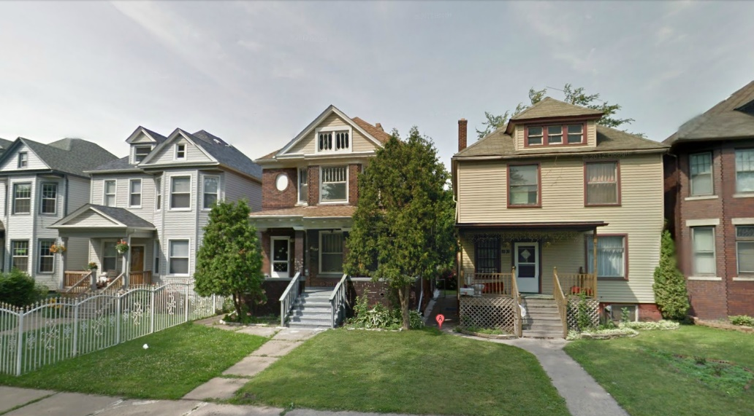
Taita’s house
The dark brown house was Taita’s house (that is Grandma in Arabic). We used to spend most of the summer’s there with her.
It wasn’t the greatest of neighborhoods but I did learn to play basketball with the local drug dealers which helped me learn how to play physical without getting into too much trouble.
Notes:
Rotating tubes with text
(Intermediate)
To reproduce the first shape effect on this slide, do the following:
On the Home tab, in the Slides group, click Layout, and then click Blank.
On the Insert tab, in the Illustrations group, click Shapes, and then under Rectangles click Rectangle (first option from the left). On the slide, drag to draw a rectangle.
Select the rectangle. Under Drawing Tools, on the Format tab, in the Size group, do the following:
In the Shape Height box, enter 0.75”.
In the Shape Width box, enter 7.42”.
Drag the rectangle above the middle of the slide, and then align the right edge with the right edge of the slide.
Under Drawing Tools, on the Format tab, in the Shape Styles group, click Shape Effects, point to Reflection, and then under Reflection Variations click Tight Reflection, touching.
On the Home tab, in the bottom right corner of the Drawing group, click the Format Shape dialog box launcher. In the Format Shape dialog box, click Fill in the left pane, select Gradient fill in the Fill pane, and then do the following:
In the Type list, select Linear.
In the Direction list, select Linear Up (second row, second option from the left).
Under Gradient stops, click Add gradient stop or Remove gradient stop until four stops appear in the slider.
Also under Gradient stops, customize the gradient stops as follows:
Select the first stop in the slider, and then do the following:
In the Position box, enter 0%.
Click the button next to Color, and then under Theme Colors click Blue, Accent 1, Lighter 40% (fourth row, fifth option from the left).
Select the next stop in the slider, and then do the following:
In the Position box, enter 26%.
Click the button next to Color, and then under Theme Colors click White, Background 1, Darker 5% (second row, first option from the left).
Select the next stop in the slider, and then do the following:
In the Position box, enter 80%.
Click the button next to Color, and then under Theme Colors click Black, Text 1, Lighter 50% (second row, second option from the left).
Select the last stop in the slider, and then do the following:
In the Position box, enter 100%.
Click the button next to Color, and then under Theme Colors click White, Background 1, Darker 35% (fifth row, first option from the left).
Also in the Format Shape dialog box, click Line Color in the left pane. In the Line Color pane, select No line.
Also in the Format Shape dialog box, click Shadow in the left pane. In the Shadow pane, click the button next to Presets, under Outer click Offset Center, and then do the following:
In the Transparency box, enter 60%.
In the Size box, enter 102%.
In the Blur box, enter 5 pt.
In the Angle box, enter 0°
In the Distance box, enter 0 pt.
On the slide, select the rectangle. On the Home tab, in the Clipboard group, click the arrow to the right of Copy, and then click Duplicate.
Select the second, duplicate rectangle. Under Drawing Tools, on the Format tab, in the Shape Styles group, click Shape Effects, point to Reflection, and then click No Reflection.
On the Home tab, in the bottom right corner of the Drawing group, click the Format Shape dialog box launcher. In the Format Shape dialog box, click Fill in the left pane. In the Fill pane, click the button next to Direction, and then click Linear Down (first row, second option from the left).
Also in the Format Shape dialog box, click Shadow in the left pane. In the Shadow pane, click the button next to Presets, and then under No Shadow click No Shadow.
On the slide, drag the second rectangle until it is directly on top of the first rectangle.
On the Home tab, in the Editing group, click Select, and then click Selection Pane.
In the Selection and Visibility pane, press and hold CTRL, and then select both rectangles. On the Home tab, in the Drawing group, click Arrange, point to Align, and then do the following:
Click Align Selected Objects.
Click Align Center.
Click Align Middle.
To reproduce the first text effect on this slide, do the following:
On the Insert tab, in the Text group, click Text Box. On the slide, drag to draw a text box.
Enter the first line of text on the slide, and then select the text. On the Home tab, in the Font group, do the following:
In the Font list, select Trebuchet MS.
In the Font Size box, enter 26.
Click Bold.
Click the arrow next to Font Color, and then under Theme Colors click Black, Text 1, Lighter 25% (fourth row, second option from the left)
On the Home tab, in the Paragraph group, click Align Text Left to align the text left in the text box.
On the slide, select the text box. Under Drawing Tools, on the Format tab, in the WordArt Styles group, click Text Effects, point to Shadow, and then click Shadow Options. In the Format Text Effects dialog box, in the Shadow pane, click the button next to Presets, under Inner click Inside Diagonal Bottom Left (third row, first option from the left), and then do the following:
Click the button next to Color, and then under Theme Colors click White, Background 1 (first row, first option from the left).
In the Transparency box, enter 21%.
In the Blur box, enter 5 pt.
In the Angle box, enter 90°.
In the Distance box, enter 4 pt.
On the slide, drag the text box onto the second (top) rectangle.
To animate the first shape and text effects on this slide, do the following:
In the Selection and Visibility pane, select the third object in the list (the first rectangle you created). On the Animations tab, in the Advanced Animation group, click Add Animation, and then under Entrance click Float In.
Also on the Animations tab, in the Animation group, click Effect Options, and then click Float Down.
Also on the Animations tab, in the Timing group, do the following:
In the Start list, select With Previous.
In the Duration box, enter 1.00 second.
In the Selection and Visibility pane, select the second object in the list (the second rectangle you created). On the Animations tab, in the Advanced Animation group, click Add Animation, and then under Entrance click Fade.
Also on the Animations tab, in the Timing group, do the following:
In the Start list, select After Previous.
In the Duration box, enter 1.00 second.
In the Selection and Visibility pane, select the first object in the list (text box). On the Animations tab, in the Advanced Animation group, click Add Animation, and then under Entrance click Wipe.
Also on the Animations tab, in the Animation group, click Effect Options, and then click From Top.
Also on the Animations tab, in the Timing group, do the following:
In the Start list, select With Previous.
In the Duration box, enter 1.00 second.
To reproduce the other animated shapes and text on this slide, do the following:
Press and hold CTRL, and then in the Selection and Visibility pane, select the two rectangles and the text box. On the Home tab, in the Clipboard group, click the arrow to the right of Copy, and then click Duplicate.
With the second group of objects still selected on the slide, drag them under the first group of objects, aligning the right edge of the rectangles with the right edge of the slide.
With the second group of objects still selected on the slide, on the Home tab, in the Clipboard group, click the arrow to the right of Copy, and then click Duplicate.
With the third group of objects still selected on the slide, drag them under the second group of objects, aligning the right edge of the rectangles with the right edge of the slide.
Click in the second and third duplicate text boxes and edit the text.
To reproduce the background effects on this slide, do the following:
Right-click the slide background area, and then click Format Background. In the Format Background dialog box, click Fill in the left pane, select Gradient fill in the Fill pane, and then do the following:
In the Type list, select Radial.
Click the button next to Direction, and then click From Center (third option from the left).
Under Gradient stops, click Add gradient stop or Remove gradient stop until two stops appear in the slider.
Also under Gradient stops, customize the gradient stops that you added as follows:
Select the first stop in the slider, and then do the following:
In the Position box, enter 0%.
Click the button next to Color, and then under Theme Colors click White, Background 1, Darker 50% (fifth row, first option from the left).
Select the last stop in the slider, and then do the following:
In the Position box, enter 100%.
Click the button next to Color, and then under Theme Colors click Black, Text 1, Lighter 5% (fifth row, second option from the left).

Slide 3
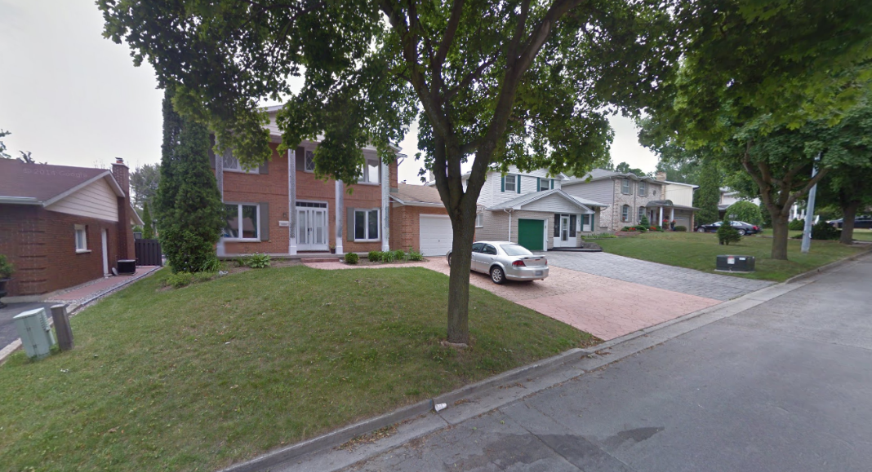
London house
This is the home where I spent most of my life. We moved here to London, Ontario, Canada when I was four yrs. old.
The snow banks in the winter would get to over 4 feet high but the summer months were absolutely beautiful. The backyards had no fences so we used to play football and soccer in the back yards. This was a great, quiet neighborhood where lots of great memories were made.
Notes:
Rotating tubes with text
(Intermediate)
To reproduce the first shape effect on this slide, do the following:
On the Home tab, in the Slides group, click Layout, and then click Blank.
On the Insert tab, in the Illustrations group, click Shapes, and then under Rectangles click Rectangle (first option from the left). On the slide, drag to draw a rectangle.
Select the rectangle. Under Drawing Tools, on the Format tab, in the Size group, do the following:
In the Shape Height box, enter 0.75”.
In the Shape Width box, enter 7.42”.
Drag the rectangle above the middle of the slide, and then align the right edge with the right edge of the slide.
Under Drawing Tools, on the Format tab, in the Shape Styles group, click Shape Effects, point to Reflection, and then under Reflection Variations click Tight Reflection, touching.
On the Home tab, in the bottom right corner of the Drawing group, click the Format Shape dialog box launcher. In the Format Shape dialog box, click Fill in the left pane, select Gradient fill in the Fill pane, and then do the following:
In the Type list, select Linear.
In the Direction list, select Linear Up (second row, second option from the left).
Under Gradient stops, click Add gradient stop or Remove gradient stop until four stops appear in the slider.
Also under Gradient stops, customize the gradient stops as follows:
Select the first stop in the slider, and then do the following:
In the Position box, enter 0%.
Click the button next to Color, and then under Theme Colors click Blue, Accent 1, Lighter 40% (fourth row, fifth option from the left).
Select the next stop in the slider, and then do the following:
In the Position box, enter 26%.
Click the button next to Color, and then under Theme Colors click White, Background 1, Darker 5% (second row, first option from the left).
Select the next stop in the slider, and then do the following:
In the Position box, enter 80%.
Click the button next to Color, and then under Theme Colors click Black, Text 1, Lighter 50% (second row, second option from the left).
Select the last stop in the slider, and then do the following:
In the Position box, enter 100%.
Click the button next to Color, and then under Theme Colors click White, Background 1, Darker 35% (fifth row, first option from the left).
Also in the Format Shape dialog box, click Line Color in the left pane. In the Line Color pane, select No line.
Also in the Format Shape dialog box, click Shadow in the left pane. In the Shadow pane, click the button next to Presets, under Outer click Offset Center, and then do the following:
In the Transparency box, enter 60%.
In the Size box, enter 102%.
In the Blur box, enter 5 pt.
In the Angle box, enter 0°
In the Distance box, enter 0 pt.
On the slide, select the rectangle. On the Home tab, in the Clipboard group, click the arrow to the right of Copy, and then click Duplicate.
Select the second, duplicate rectangle. Under Drawing Tools, on the Format tab, in the Shape Styles group, click Shape Effects, point to Reflection, and then click No Reflection.
On the Home tab, in the bottom right corner of the Drawing group, click the Format Shape dialog box launcher. In the Format Shape dialog box, click Fill in the left pane. In the Fill pane, click the button next to Direction, and then click Linear Down (first row, second option from the left).
Also in the Format Shape dialog box, click Shadow in the left pane. In the Shadow pane, click the button next to Presets, and then under No Shadow click No Shadow.
On the slide, drag the second rectangle until it is directly on top of the first rectangle.
On the Home tab, in the Editing group, click Select, and then click Selection Pane.
In the Selection and Visibility pane, press and hold CTRL, and then select both rectangles. On the Home tab, in the Drawing group, click Arrange, point to Align, and then do the following:
Click Align Selected Objects.
Click Align Center.
Click Align Middle.
To reproduce the first text effect on this slide, do the following:
On the Insert tab, in the Text group, click Text Box. On the slide, drag to draw a text box.
Enter the first line of text on the slide, and then select the text. On the Home tab, in the Font group, do the following:
In the Font list, select Trebuchet MS.
In the Font Size box, enter 26.
Click Bold.
Click the arrow next to Font Color, and then under Theme Colors click Black, Text 1, Lighter 25% (fourth row, second option from the left)
On the Home tab, in the Paragraph group, click Align Text Left to align the text left in the text box.
On the slide, select the text box. Under Drawing Tools, on the Format tab, in the WordArt Styles group, click Text Effects, point to Shadow, and then click Shadow Options. In the Format Text Effects dialog box, in the Shadow pane, click the button next to Presets, under Inner click Inside Diagonal Bottom Left (third row, first option from the left), and then do the following:
Click the button next to Color, and then under Theme Colors click White, Background 1 (first row, first option from the left).
In the Transparency box, enter 21%.
In the Blur box, enter 5 pt.
In the Angle box, enter 90°.
In the Distance box, enter 4 pt.
On the slide, drag the text box onto the second (top) rectangle.
To animate the first shape and text effects on this slide, do the following:
In the Selection and Visibility pane, select the third object in the list (the first rectangle you created). On the Animations tab, in the Advanced Animation group, click Add Animation, and then under Entrance click Float In.
Also on the Animations tab, in the Animation group, click Effect Options, and then click Float Down.
Also on the Animations tab, in the Timing group, do the following:
In the Start list, select With Previous.
In the Duration box, enter 1.00 second.
In the Selection and Visibility pane, select the second object in the list (the second rectangle you created). On the Animations tab, in the Advanced Animation group, click Add Animation, and then under Entrance click Fade.
Also on the Animations tab, in the Timing group, do the following:
In the Start list, select After Previous.
In the Duration box, enter 1.00 second.
In the Selection and Visibility pane, select the first object in the list (text box). On the Animations tab, in the Advanced Animation group, click Add Animation, and then under Entrance click Wipe.
Also on the Animations tab, in the Animation group, click Effect Options, and then click From Top.
Also on the Animations tab, in the Timing group, do the following:
In the Start list, select With Previous.
In the Duration box, enter 1.00 second.
To reproduce the other animated shapes and text on this slide, do the following:
Press and hold CTRL, and then in the Selection and Visibility pane, select the two rectangles and the text box. On the Home tab, in the Clipboard group, click the arrow to the right of Copy, and then click Duplicate.
With the second group of objects still selected on the slide, drag them under the first group of objects, aligning the right edge of the rectangles with the right edge of the slide.
With the second group of objects still selected on the slide, on the Home tab, in the Clipboard group, click the arrow to the right of Copy, and then click Duplicate.
With the third group of objects still selected on the slide, drag them under the second group of objects, aligning the right edge of the rectangles with the right edge of the slide.
Click in the second and third duplicate text boxes and edit the text.
To reproduce the background effects on this slide, do the following:
Right-click the slide background area, and then click Format Background. In the Format Background dialog box, click Fill in the left pane, select Gradient fill in the Fill pane, and then do the following:
In the Type list, select Radial.
Click the button next to Direction, and then click From Center (third option from the left).
Under Gradient stops, click Add gradient stop or Remove gradient stop until two stops appear in the slider.
Also under Gradient stops, customize the gradient stops that you added as follows:
Select the first stop in the slider, and then do the following:
In the Position box, enter 0%.
Click the button next to Color, and then under Theme Colors click White, Background 1, Darker 50% (fifth row, first option from the left).
Select the last stop in the slider, and then do the following:
In the Position box, enter 100%.
Click the button next to Color, and then under Theme Colors click Black, Text 1, Lighter 5% (fifth row, second option from the left).

Slide 4
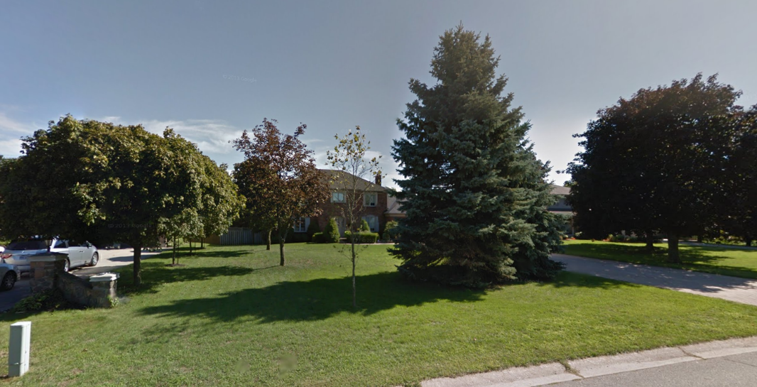
Lambeth house
I left home at the age of sixteen and moved in with the family of a good friend. I lived here for a year before moving to the United States.
This was a small farm town where we would ride dirt bikes around on the neighborhood streets and then off in the fields too. There was a really nice farmer who used to setup an outdoor ice rink in the winter for us kids to play hockey after school.

Slide 5
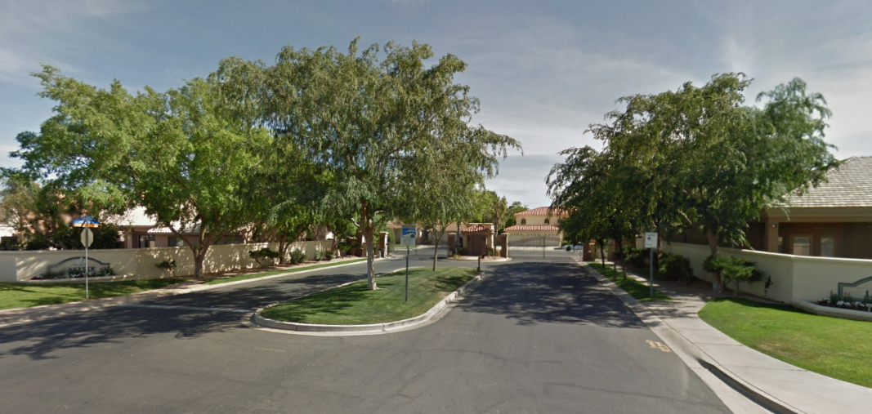
Gilbert House - HS
This is where I lived during high school in Gilbert, Arizona. I lived with my friend’s family but basically we had an apartment in the basement all to ourselves. It was my friend Rob’s family and another friend named Big John and I lived with him there.
Rob and I both got into motorcycles that year and ended up buying one each. We never did anything crazy but we had lots of fun (while still getting our homework done).

Slide 6
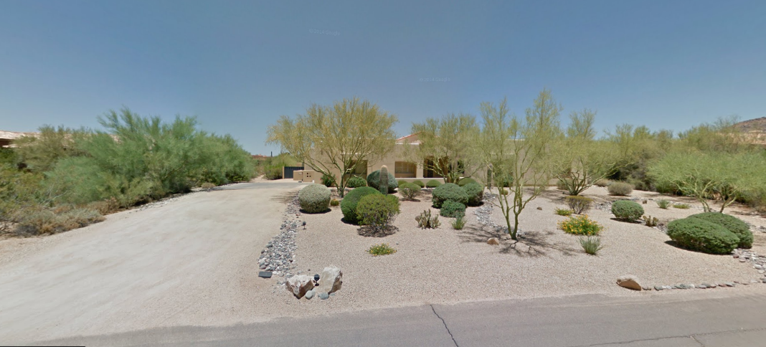
Scottsdale house
While I was serving my mission in London, England, the Lundell family (Rob’s family) moved from Gilbert to Scottsdale. I returned in 1999 to live here with them until I got my own place.
They weren’t much into grass in Scottsdale so this home had none. It was a nice ranch style home with plenty of space. The evening sunsets up here were amazing.

Slide 7

My first Apartment
In 2000, I got my own apartment. I was literally on my own for the 1st time in my life. It was short lived though, my beautiful bride-to-be was moving in two weeks later after our wedding day. This was our first home together. It was called Gilbert Meadows back then.
Notes:
Rotating tubes with text
(Intermediate)
To reproduce the first shape effect on this slide, do the following:
On the Home tab, in the Slides group, click Layout, and then click Blank.
On the Insert tab, in the Illustrations group, click Shapes, and then under Rectangles click Rectangle (first option from the left). On the slide, drag to draw a rectangle.
Select the rectangle. Under Drawing Tools, on the Format tab, in the Size group, do the following:
In the Shape Height box, enter 0.75”.
In the Shape Width box, enter 7.42”.
Drag the rectangle above the middle of the slide, and then align the right edge with the right edge of the slide.
Under Drawing Tools, on the Format tab, in the Shape Styles group, click Shape Effects, point to Reflection, and then under Reflection Variations click Tight Reflection, touching.
On the Home tab, in the bottom right corner of the Drawing group, click the Format Shape dialog box launcher. In the Format Shape dialog box, click Fill in the left pane, select Gradient fill in the Fill pane, and then do the following:
In the Type list, select Linear.
In the Direction list, select Linear Up (second row, second option from the left).
Under Gradient stops, click Add gradient stop or Remove gradient stop until four stops appear in the slider.
Also under Gradient stops, customize the gradient stops as follows:
Select the first stop in the slider, and then do the following:
In the Position box, enter 0%.
Click the button next to Color, and then under Theme Colors click Blue, Accent 1, Lighter 40% (fourth row, fifth option from the left).
Select the next stop in the slider, and then do the following:
In the Position box, enter 26%.
Click the button next to Color, and then under Theme Colors click White, Background 1, Darker 5% (second row, first option from the left).
Select the next stop in the slider, and then do the following:
In the Position box, enter 80%.
Click the button next to Color, and then under Theme Colors click Black, Text 1, Lighter 50% (second row, second option from the left).
Select the last stop in the slider, and then do the following:
In the Position box, enter 100%.
Click the button next to Color, and then under Theme Colors click White, Background 1, Darker 35% (fifth row, first option from the left).
Also in the Format Shape dialog box, click Line Color in the left pane. In the Line Color pane, select No line.
Also in the Format Shape dialog box, click Shadow in the left pane. In the Shadow pane, click the button next to Presets, under Outer click Offset Center, and then do the following:
In the Transparency box, enter 60%.
In the Size box, enter 102%.
In the Blur box, enter 5 pt.
In the Angle box, enter 0°
In the Distance box, enter 0 pt.
On the slide, select the rectangle. On the Home tab, in the Clipboard group, click the arrow to the right of Copy, and then click Duplicate.
Select the second, duplicate rectangle. Under Drawing Tools, on the Format tab, in the Shape Styles group, click Shape Effects, point to Reflection, and then click No Reflection.
On the Home tab, in the bottom right corner of the Drawing group, click the Format Shape dialog box launcher. In the Format Shape dialog box, click Fill in the left pane. In the Fill pane, click the button next to Direction, and then click Linear Down (first row, second option from the left).
Also in the Format Shape dialog box, click Shadow in the left pane. In the Shadow pane, click the button next to Presets, and then under No Shadow click No Shadow.
On the slide, drag the second rectangle until it is directly on top of the first rectangle.
On the Home tab, in the Editing group, click Select, and then click Selection Pane.
In the Selection and Visibility pane, press and hold CTRL, and then select both rectangles. On the Home tab, in the Drawing group, click Arrange, point to Align, and then do the following:
Click Align Selected Objects.
Click Align Center.
Click Align Middle.
To reproduce the first text effect on this slide, do the following:
On the Insert tab, in the Text group, click Text Box. On the slide, drag to draw a text box.
Enter the first line of text on the slide, and then select the text. On the Home tab, in the Font group, do the following:
In the Font list, select Trebuchet MS.
In the Font Size box, enter 26.
Click Bold.
Click the arrow next to Font Color, and then under Theme Colors click Black, Text 1, Lighter 25% (fourth row, second option from the left)
On the Home tab, in the Paragraph group, click Align Text Left to align the text left in the text box.
On the slide, select the text box. Under Drawing Tools, on the Format tab, in the WordArt Styles group, click Text Effects, point to Shadow, and then click Shadow Options. In the Format Text Effects dialog box, in the Shadow pane, click the button next to Presets, under Inner click Inside Diagonal Bottom Left (third row, first option from the left), and then do the following:
Click the button next to Color, and then under Theme Colors click White, Background 1 (first row, first option from the left).
In the Transparency box, enter 21%.
In the Blur box, enter 5 pt.
In the Angle box, enter 90°.
In the Distance box, enter 4 pt.
On the slide, drag the text box onto the second (top) rectangle.
To animate the first shape and text effects on this slide, do the following:
In the Selection and Visibility pane, select the third object in the list (the first rectangle you created). On the Animations tab, in the Advanced Animation group, click Add Animation, and then under Entrance click Float In.
Also on the Animations tab, in the Animation group, click Effect Options, and then click Float Down.
Also on the Animations tab, in the Timing group, do the following:
In the Start list, select With Previous.
In the Duration box, enter 1.00 second.
In the Selection and Visibility pane, select the second object in the list (the second rectangle you created). On the Animations tab, in the Advanced Animation group, click Add Animation, and then under Entrance click Fade.
Also on the Animations tab, in the Timing group, do the following:
In the Start list, select After Previous.
In the Duration box, enter 1.00 second.
In the Selection and Visibility pane, select the first object in the list (text box). On the Animations tab, in the Advanced Animation group, click Add Animation, and then under Entrance click Wipe.
Also on the Animations tab, in the Animation group, click Effect Options, and then click From Top.
Also on the Animations tab, in the Timing group, do the following:
In the Start list, select With Previous.
In the Duration box, enter 1.00 second.
To reproduce the other animated shapes and text on this slide, do the following:
Press and hold CTRL, and then in the Selection and Visibility pane, select the two rectangles and the text box. On the Home tab, in the Clipboard group, click the arrow to the right of Copy, and then click Duplicate.
With the second group of objects still selected on the slide, drag them under the first group of objects, aligning the right edge of the rectangles with the right edge of the slide.
With the second group of objects still selected on the slide, on the Home tab, in the Clipboard group, click the arrow to the right of Copy, and then click Duplicate.
With the third group of objects still selected on the slide, drag them under the second group of objects, aligning the right edge of the rectangles with the right edge of the slide.
Click in the second and third duplicate text boxes and edit the text.
To reproduce the background effects on this slide, do the following:
Right-click the slide background area, and then click Format Background. In the Format Background dialog box, click Fill in the left pane, select Gradient fill in the Fill pane, and then do the following:
In the Type list, select Radial.
Click the button next to Direction, and then click From Center (third option from the left).
Under Gradient stops, click Add gradient stop or Remove gradient stop until two stops appear in the slider.
Also under Gradient stops, customize the gradient stops that you added as follows:
Select the first stop in the slider, and then do the following:
In the Position box, enter 0%.
Click the button next to Color, and then under Theme Colors click White, Background 1, Darker 50% (fifth row, first option from the left).
Select the last stop in the slider, and then do the following:
In the Position box, enter 100%.
Click the button next to Color, and then under Theme Colors click Black, Text 1, Lighter 5% (fifth row, second option from the left).

Slide 8
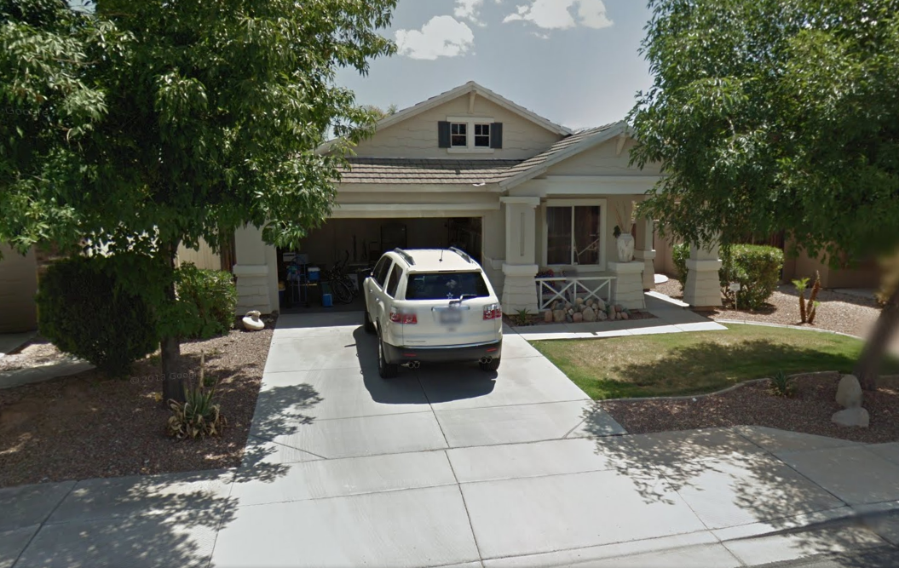
Our 1st house
This was our ‘starter house’, a nice 1200 sqft home on the east side of Gilbert, AZ. We really enjoyed this house and met some great people here. This is the 1st home our two oldest children called home.
Notes:
Rotating tubes with text
(Intermediate)
To reproduce the first shape effect on this slide, do the following:
On the Home tab, in the Slides group, click Layout, and then click Blank.
On the Insert tab, in the Illustrations group, click Shapes, and then under Rectangles click Rectangle (first option from the left). On the slide, drag to draw a rectangle.
Select the rectangle. Under Drawing Tools, on the Format tab, in the Size group, do the following:
In the Shape Height box, enter 0.75”.
In the Shape Width box, enter 7.42”.
Drag the rectangle above the middle of the slide, and then align the right edge with the right edge of the slide.
Under Drawing Tools, on the Format tab, in the Shape Styles group, click Shape Effects, point to Reflection, and then under Reflection Variations click Tight Reflection, touching.
On the Home tab, in the bottom right corner of the Drawing group, click the Format Shape dialog box launcher. In the Format Shape dialog box, click Fill in the left pane, select Gradient fill in the Fill pane, and then do the following:
In the Type list, select Linear.
In the Direction list, select Linear Up (second row, second option from the left).
Under Gradient stops, click Add gradient stop or Remove gradient stop until four stops appear in the slider.
Also under Gradient stops, customize the gradient stops as follows:
Select the first stop in the slider, and then do the following:
In the Position box, enter 0%.
Click the button next to Color, and then under Theme Colors click Blue, Accent 1, Lighter 40% (fourth row, fifth option from the left).
Select the next stop in the slider, and then do the following:
In the Position box, enter 26%.
Click the button next to Color, and then under Theme Colors click White, Background 1, Darker 5% (second row, first option from the left).
Select the next stop in the slider, and then do the following:
In the Position box, enter 80%.
Click the button next to Color, and then under Theme Colors click Black, Text 1, Lighter 50% (second row, second option from the left).
Select the last stop in the slider, and then do the following:
In the Position box, enter 100%.
Click the button next to Color, and then under Theme Colors click White, Background 1, Darker 35% (fifth row, first option from the left).
Also in the Format Shape dialog box, click Line Color in the left pane. In the Line Color pane, select No line.
Also in the Format Shape dialog box, click Shadow in the left pane. In the Shadow pane, click the button next to Presets, under Outer click Offset Center, and then do the following:
In the Transparency box, enter 60%.
In the Size box, enter 102%.
In the Blur box, enter 5 pt.
In the Angle box, enter 0°
In the Distance box, enter 0 pt.
On the slide, select the rectangle. On the Home tab, in the Clipboard group, click the arrow to the right of Copy, and then click Duplicate.
Select the second, duplicate rectangle. Under Drawing Tools, on the Format tab, in the Shape Styles group, click Shape Effects, point to Reflection, and then click No Reflection.
On the Home tab, in the bottom right corner of the Drawing group, click the Format Shape dialog box launcher. In the Format Shape dialog box, click Fill in the left pane. In the Fill pane, click the button next to Direction, and then click Linear Down (first row, second option from the left).
Also in the Format Shape dialog box, click Shadow in the left pane. In the Shadow pane, click the button next to Presets, and then under No Shadow click No Shadow.
On the slide, drag the second rectangle until it is directly on top of the first rectangle.
On the Home tab, in the Editing group, click Select, and then click Selection Pane.
In the Selection and Visibility pane, press and hold CTRL, and then select both rectangles. On the Home tab, in the Drawing group, click Arrange, point to Align, and then do the following:
Click Align Selected Objects.
Click Align Center.
Click Align Middle.
To reproduce the first text effect on this slide, do the following:
On the Insert tab, in the Text group, click Text Box. On the slide, drag to draw a text box.
Enter the first line of text on the slide, and then select the text. On the Home tab, in the Font group, do the following:
In the Font list, select Trebuchet MS.
In the Font Size box, enter 26.
Click Bold.
Click the arrow next to Font Color, and then under Theme Colors click Black, Text 1, Lighter 25% (fourth row, second option from the left)
On the Home tab, in the Paragraph group, click Align Text Left to align the text left in the text box.
On the slide, select the text box. Under Drawing Tools, on the Format tab, in the WordArt Styles group, click Text Effects, point to Shadow, and then click Shadow Options. In the Format Text Effects dialog box, in the Shadow pane, click the button next to Presets, under Inner click Inside Diagonal Bottom Left (third row, first option from the left), and then do the following:
Click the button next to Color, and then under Theme Colors click White, Background 1 (first row, first option from the left).
In the Transparency box, enter 21%.
In the Blur box, enter 5 pt.
In the Angle box, enter 90°.
In the Distance box, enter 4 pt.
On the slide, drag the text box onto the second (top) rectangle.
To animate the first shape and text effects on this slide, do the following:
In the Selection and Visibility pane, select the third object in the list (the first rectangle you created). On the Animations tab, in the Advanced Animation group, click Add Animation, and then under Entrance click Float In.
Also on the Animations tab, in the Animation group, click Effect Options, and then click Float Down.
Also on the Animations tab, in the Timing group, do the following:
In the Start list, select With Previous.
In the Duration box, enter 1.00 second.
In the Selection and Visibility pane, select the second object in the list (the second rectangle you created). On the Animations tab, in the Advanced Animation group, click Add Animation, and then under Entrance click Fade.
Also on the Animations tab, in the Timing group, do the following:
In the Start list, select After Previous.
In the Duration box, enter 1.00 second.
In the Selection and Visibility pane, select the first object in the list (text box). On the Animations tab, in the Advanced Animation group, click Add Animation, and then under Entrance click Wipe.
Also on the Animations tab, in the Animation group, click Effect Options, and then click From Top.
Also on the Animations tab, in the Timing group, do the following:
In the Start list, select With Previous.
In the Duration box, enter 1.00 second.
To reproduce the other animated shapes and text on this slide, do the following:
Press and hold CTRL, and then in the Selection and Visibility pane, select the two rectangles and the text box. On the Home tab, in the Clipboard group, click the arrow to the right of Copy, and then click Duplicate.
With the second group of objects still selected on the slide, drag them under the first group of objects, aligning the right edge of the rectangles with the right edge of the slide.
With the second group of objects still selected on the slide, on the Home tab, in the Clipboard group, click the arrow to the right of Copy, and then click Duplicate.
With the third group of objects still selected on the slide, drag them under the second group of objects, aligning the right edge of the rectangles with the right edge of the slide.
Click in the second and third duplicate text boxes and edit the text.
To reproduce the background effects on this slide, do the following:
Right-click the slide background area, and then click Format Background. In the Format Background dialog box, click Fill in the left pane, select Gradient fill in the Fill pane, and then do the following:
In the Type list, select Radial.
Click the button next to Direction, and then click From Center (third option from the left).
Under Gradient stops, click Add gradient stop or Remove gradient stop until two stops appear in the slider.
Also under Gradient stops, customize the gradient stops that you added as follows:
Select the first stop in the slider, and then do the following:
In the Position box, enter 0%.
Click the button next to Color, and then under Theme Colors click White, Background 1, Darker 50% (fifth row, first option from the left).
Select the last stop in the slider, and then do the following:
In the Position box, enter 100%.
Click the button next to Color, and then under Theme Colors click Black, Text 1, Lighter 5% (fifth row, second option from the left).

Slide 9
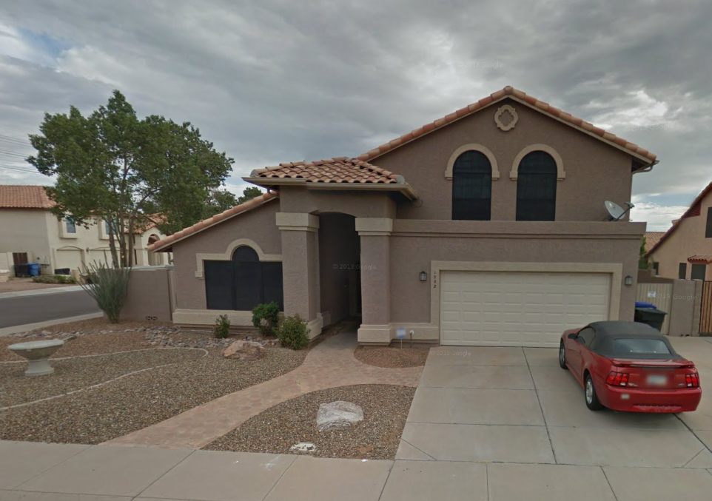
Gilbert house #2
This is the home that my wife spent her high school years in. As luck would have it, my in-laws were looking to sell it around the time Brianne and I were looking for a bigger place. We ended up buying it from them and lived here from 2002-2006. It had a great floorplan, plenty of room for our growing family and it is the only house we’ve had that had a pool. I miss that pool…

Slide 10
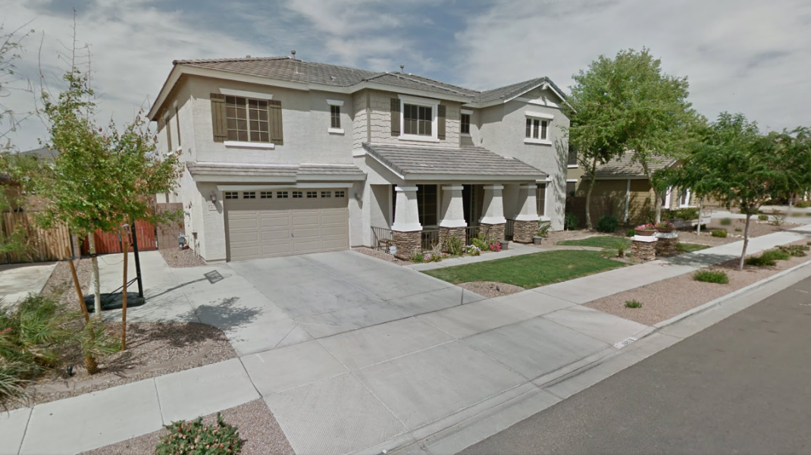
Queen Creek house
Queen Creek was a farm town 15 miles outside of Gilbert when I first arrived in 1995. I swore I’d never live there because it was so far from everything else…as you can see from the below, I was wrong. My wife found this beautiful neighborhood and convinced me we should live there, lucky for me I listened. We enjoyed some amazing times in this house, made life-long friends and welcomed three new additions to our family while living here.

Slide 11
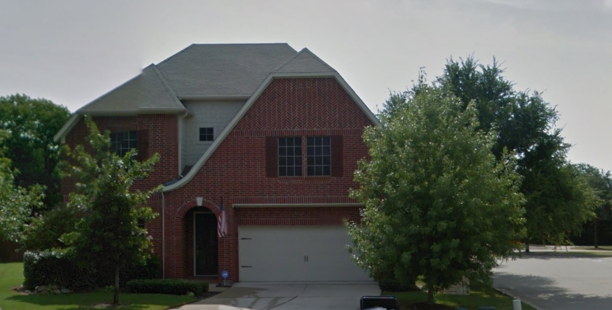
Texas house
In 2013 we found our own patch of heaven in North Texas. I moved her for a new work assignment and the whole family fell in love with this place almost immediately. We have a great big backyard and we live in a small town of ~7500 people. There is a small town vibe everywhere you go and we love it.
Notes:
Rotating tubes with text
(Intermediate)
To reproduce the first shape effect on this slide, do the following:
On the Home tab, in the Slides group, click Layout, and then click Blank.
On the Insert tab, in the Illustrations group, click Shapes, and then under Rectangles click Rectangle (first option from the left). On the slide, drag to draw a rectangle.
Select the rectangle. Under Drawing Tools, on the Format tab, in the Size group, do the following:
In the Shape Height box, enter 0.75”.
In the Shape Width box, enter 7.42”.
Drag the rectangle above the middle of the slide, and then align the right edge with the right edge of the slide.
Under Drawing Tools, on the Format tab, in the Shape Styles group, click Shape Effects, point to Reflection, and then under Reflection Variations click Tight Reflection, touching.
On the Home tab, in the bottom right corner of the Drawing group, click the Format Shape dialog box launcher. In the Format Shape dialog box, click Fill in the left pane, select Gradient fill in the Fill pane, and then do the following:
In the Type list, select Linear.
In the Direction list, select Linear Up (second row, second option from the left).
Under Gradient stops, click Add gradient stop or Remove gradient stop until four stops appear in the slider.
Also under Gradient stops, customize the gradient stops as follows:
Select the first stop in the slider, and then do the following:
In the Position box, enter 0%.
Click the button next to Color, and then under Theme Colors click Blue, Accent 1, Lighter 40% (fourth row, fifth option from the left).
Select the next stop in the slider, and then do the following:
In the Position box, enter 26%.
Click the button next to Color, and then under Theme Colors click White, Background 1, Darker 5% (second row, first option from the left).
Select the next stop in the slider, and then do the following:
In the Position box, enter 80%.
Click the button next to Color, and then under Theme Colors click Black, Text 1, Lighter 50% (second row, second option from the left).
Select the last stop in the slider, and then do the following:
In the Position box, enter 100%.
Click the button next to Color, and then under Theme Colors click White, Background 1, Darker 35% (fifth row, first option from the left).
Also in the Format Shape dialog box, click Line Color in the left pane. In the Line Color pane, select No line.
Also in the Format Shape dialog box, click Shadow in the left pane. In the Shadow pane, click the button next to Presets, under Outer click Offset Center, and then do the following:
In the Transparency box, enter 60%.
In the Size box, enter 102%.
In the Blur box, enter 5 pt.
In the Angle box, enter 0°
In the Distance box, enter 0 pt.
On the slide, select the rectangle. On the Home tab, in the Clipboard group, click the arrow to the right of Copy, and then click Duplicate.
Select the second, duplicate rectangle. Under Drawing Tools, on the Format tab, in the Shape Styles group, click Shape Effects, point to Reflection, and then click No Reflection.
On the Home tab, in the bottom right corner of the Drawing group, click the Format Shape dialog box launcher. In the Format Shape dialog box, click Fill in the left pane. In the Fill pane, click the button next to Direction, and then click Linear Down (first row, second option from the left).
Also in the Format Shape dialog box, click Shadow in the left pane. In the Shadow pane, click the button next to Presets, and then under No Shadow click No Shadow.
On the slide, drag the second rectangle until it is directly on top of the first rectangle.
On the Home tab, in the Editing group, click Select, and then click Selection Pane.
In the Selection and Visibility pane, press and hold CTRL, and then select both rectangles. On the Home tab, in the Drawing group, click Arrange, point to Align, and then do the following:
Click Align Selected Objects.
Click Align Center.
Click Align Middle.
To reproduce the first text effect on this slide, do the following:
On the Insert tab, in the Text group, click Text Box. On the slide, drag to draw a text box.
Enter the first line of text on the slide, and then select the text. On the Home tab, in the Font group, do the following:
In the Font list, select Trebuchet MS.
In the Font Size box, enter 26.
Click Bold.
Click the arrow next to Font Color, and then under Theme Colors click Black, Text 1, Lighter 25% (fourth row, second option from the left)
On the Home tab, in the Paragraph group, click Align Text Left to align the text left in the text box.
On the slide, select the text box. Under Drawing Tools, on the Format tab, in the WordArt Styles group, click Text Effects, point to Shadow, and then click Shadow Options. In the Format Text Effects dialog box, in the Shadow pane, click the button next to Presets, under Inner click Inside Diagonal Bottom Left (third row, first option from the left), and then do the following:
Click the button next to Color, and then under Theme Colors click White, Background 1 (first row, first option from the left).
In the Transparency box, enter 21%.
In the Blur box, enter 5 pt.
In the Angle box, enter 90°.
In the Distance box, enter 4 pt.
On the slide, drag the text box onto the second (top) rectangle.
To animate the first shape and text effects on this slide, do the following:
In the Selection and Visibility pane, select the third object in the list (the first rectangle you created). On the Animations tab, in the Advanced Animation group, click Add Animation, and then under Entrance click Float In.
Also on the Animations tab, in the Animation group, click Effect Options, and then click Float Down.
Also on the Animations tab, in the Timing group, do the following:
In the Start list, select With Previous.
In the Duration box, enter 1.00 second.
In the Selection and Visibility pane, select the second object in the list (the second rectangle you created). On the Animations tab, in the Advanced Animation group, click Add Animation, and then under Entrance click Fade.
Also on the Animations tab, in the Timing group, do the following:
In the Start list, select After Previous.
In the Duration box, enter 1.00 second.
In the Selection and Visibility pane, select the first object in the list (text box). On the Animations tab, in the Advanced Animation group, click Add Animation, and then under Entrance click Wipe.
Also on the Animations tab, in the Animation group, click Effect Options, and then click From Top.
Also on the Animations tab, in the Timing group, do the following:
In the Start list, select With Previous.
In the Duration box, enter 1.00 second.
To reproduce the other animated shapes and text on this slide, do the following:
Press and hold CTRL, and then in the Selection and Visibility pane, select the two rectangles and the text box. On the Home tab, in the Clipboard group, click the arrow to the right of Copy, and then click Duplicate.
With the second group of objects still selected on the slide, drag them under the first group of objects, aligning the right edge of the rectangles with the right edge of the slide.
With the second group of objects still selected on the slide, on the Home tab, in the Clipboard group, click the arrow to the right of Copy, and then click Duplicate.
With the third group of objects still selected on the slide, drag them under the second group of objects, aligning the right edge of the rectangles with the right edge of the slide.
Click in the second and third duplicate text boxes and edit the text.
To reproduce the background effects on this slide, do the following:
Right-click the slide background area, and then click Format Background. In the Format Background dialog box, click Fill in the left pane, select Gradient fill in the Fill pane, and then do the following:
In the Type list, select Radial.
Click the button next to Direction, and then click From Center (third option from the left).
Under Gradient stops, click Add gradient stop or Remove gradient stop until two stops appear in the slider.
Also under Gradient stops, customize the gradient stops that you added as follows:
Select the first stop in the slider, and then do the following:
In the Position box, enter 0%.
Click the button next to Color, and then under Theme Colors click White, Background 1, Darker 50% (fifth row, first option from the left).
Select the last stop in the slider, and then do the following:
In the Position box, enter 100%.
Click the button next to Color, and then under Theme Colors click Black, Text 1, Lighter 5% (fifth row, second option from the left).

